Slide 1
GRAPH SEARCH:
BREADTH-FIRST SEARCH (BFS)
DEPTH-FIRST SEARCH (DFS)

Slide 2
Some Graph Operations
Traversal
Given G=(V,E) and vertex v, find all w∈V,
such that w connects v.
  Depth First Search (DFS)
  preorder tree traversal
  Breadth First Search (BFS)
  level order tree traversal
Connected Components

Slide 3
BREADTH-FIRST AND DEPTH-FIRST SEARCH
BFS Basic Algorithm
BFS Complexity
DFS Algorithm
DFS Implementation
Relation between BFS and DFS

Slide 4
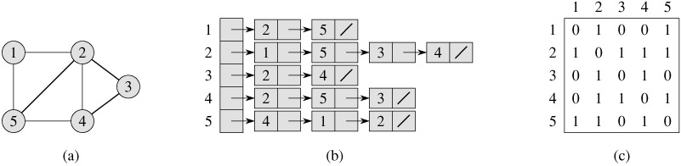
GRAPH REPRESENTATION
graph
Adjacency list
Adjacency matrix

Slide 5
GRAPH TRAVERSAL
Problem: Search for a certain node or traverse all nodes in the graph
Depth First Search
  Once a possible path is found, continue the search until the end of the path
Breadth First Search
  Start several paths at a time, and advance in each one step at a time

Slide 6
GRAPH TRAVERSAL (CONTD.)
In both DFS and BFS, the nodes of the undirected graph are visited in a systematic manner so that every node is visited exactly one.
Both BFS and DFS give rise to a tree:
  When a node x is visited, it is labeled as visited, and it is added to the tree.
  If the traversal got to node x from node y, y is viewed as the parent of x, and x a child of y.

Slide 7
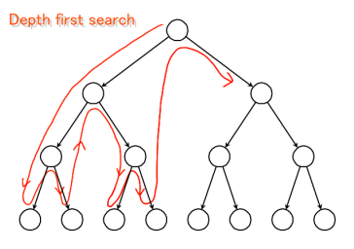
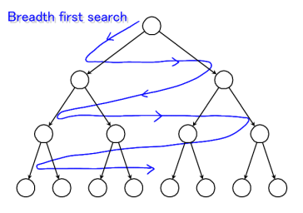
GRAPH TRAVERSALS

Slide 8
BREADTH-FIRST SEARCH
BFS follows the following rules:
  Select an unvisited node x, visit it, have it be the root in a BFS tree being formed. Its level is called the current level.
  From each node z in the current level, in the order in which the level nodes were visited, visit all the unvisited neighbors of z. The newly visited nodes from this level form a new level that becomes the next current level.
  Repeat step 2 until no more nodes can be visited.
  If there are still unvisited nodes, repeat from Step 1.

Slide 9
IMPLEMENTATION OF BFS
Observations:
  the first node visited in each level is the first node from which to proceed to visit new nodes.
This suggests that a queue is the proper data structure to remember the order of the steps.

Slide 10
BREADTH-FIRST SEARCH: EXAMPLE
r
s
t
u
∞
∞
∞
∞
∞
∞
∞
∞
v
w
x
y

Slide 11
BREADTH-FIRST SEARCH: EXAMPLE
r
s
t
u
∞
0
∞
∞
∞
∞
∞
∞
v
w
x
y
Q:
s

Slide 12
BREADTH-FIRST SEARCH: EXAMPLE
r
s
t
u
1
0
∞
∞
∞
1
∞
∞
v
w
x
y
Q:
w
r

Slide 13
BREADTH-FIRST SEARCH: EXAMPLE
r
s
t
u
1
0
2
∞
∞
1
2
∞
v
w
x
y
Q:
r
t
x

Slide 14
BREADTH-FIRST SEARCH: EXAMPLE
r
s
t
u
1
0
2
∞
2
1
2
∞
v
w
x
y
Q:
t
x
v

Slide 15
BREADTH-FIRST SEARCH: EXAMPLE
r
s
t
u
1
0
2
3
2
1
2
∞
v
w
x
y
Q:
x
v
u

Slide 16
BREADTH-FIRST SEARCH: EXAMPLE
r
s
t
u
1
0
2
3
2
1
2
3
v
w
x
y
Q:
v
u
y

Slide 17
BREADTH-FIRST SEARCH: EXAMPLE
r
s
t
u
1
0
2
3
2
1
2
3
v
w
x
y
Q:
u
y

Slide 18
BREADTH-FIRST SEARCH: EXAMPLE
r
s
t
u
1
0
2
3
2
1
2
3
v
w
x
y
Q:
y

Slide 19
BREADTH-FIRST SEARCH: EXAMPLE
r
s
t
u
1
0
2
3
2
1
2
3
v
w
x
y
Q:
Ø

Slide 20
BFS (NON RECURSIVE ALGORITHM)
BFS(V,E,s)
For all nodes except s
d[v]=∞
d[s]=0
Q= s
While Q ≠ Ø
u= Dequeue(Q)
for all adjacent nodes v of u
if d[v]= ∞
then d[v]=d[u]+1
Enqueue(Q,v)

Slide 21
BFS (TIME COMPLEXITY)
BFS(V,E,s)
For all nodes except s
d[v]=∞
d[s]=0
Q= Ø
While Q ≠ Ø
u= Dequeue(Q)
for all adjacent nodes v of u
if d[v]= ∞
then d[v]=d[u]+1
Enqueue(Q,v)
O(|V|)
O(V²) = |E|).
Overall complexity = O(|V|)+ |E|)

Slide 22
DEPTH-FIRST SEARCH
Depth-first search is another strategy for exploring a graph
  Explore “deeper” in the graph whenever possible.
  Edges are explored out of the most recently discovered vertex v that still has unexplored edges.
  When all of v’s edges have been explored, backtrack to the vertex from which v was discovered.

Slide 23
DEPTH-FIRST SEARCH
Vertices initially colored white
Then colored gray when discovered
Then black when finished

Slide 24
DFS EXAMPLE
source
vertex

Slide 25
DFS EXAMPLE
source
vertex
d f
1 |
|
|
|
|
|
|
|

Slide 26
DFS EXAMPLE
source
vertex
d f
1 |
|
|
2 |
|
|
|
|

Slide 27
DFS EXAMPLE
source
vertex
d f
1 |
|
|
2 |
|
3 |
|
|

Slide 28
DFS EXAMPLE
source
vertex
d f
1 |
|
|
2 |
|
3 | 4
|
|

Slide 29
DFS EXAMPLE
source
vertex
d f
1 |
|
|
2 |
|
3 | 4
5 |
|

Slide 30
DFS EXAMPLE
source
vertex
d f
1 |
|
|
2 |
|
3 | 4
5 | 6
|

Slide 31
DFS EXAMPLE
source
vertex
d f
1 |
8 |
|
2 | 7
|
3 | 4
5 | 6
|

Slide 32
DFS EXAMPLE
source
vertex
d f
1 |
8 |
|
2 | 7
|
3 | 4
5 | 6
|

Slide 33
DFS EXAMPLE
source
vertex
d f
1 |
8 |
|
2 | 7
9 |
3 | 4
5 | 6
|

Slide 34
DFS EXAMPLE
source
vertex
d f
1 |
8 |
|
2 | 7
9 |10
3 | 4
5 | 6
|

Slide 35
DFS EXAMPLE
source
vertex
d f
1 |
8 |11
|
2 | 7
9 |10
3 | 4
5 | 6
|

Slide 36
DFS EXAMPLE
source
vertex
d f
1 |12
8 |11
|
2 | 7
9 |10
3 | 4
5 | 6
|

Slide 37
DFS EXAMPLE
source
vertex
d f
1 |12
8 |11
13|
2 | 7
9 |10
3 | 4
5 | 6
|

Slide 38
DFS EXAMPLE
source
vertex
d f
1 |12
8 |11
13|
2 | 7
9 |10
3 | 4
5 | 6
14|

Slide 39
DFS EXAMPLE
source
vertex
d f
1 |12
8 |11
13|
2 | 7
9 |10
3 | 4
5 | 6
14|15

Slide 40
DFS EXAMPLE
source
vertex
d f
1 |12
8 |11
13|16
2 | 7
9 |10
3 | 4
5 | 6
14|15

Slide 41
DFS ITERATIVE ALGORITHM
DFS-iterative (G, x): //Where G is graph and x is source vertex
let S be stack
S.push( x ) //Inserting x in stack
mark x as visited.
while ( S is not empty):
  v = S.top( ) //Pop a vertex from stack to visit next
S.pop( )
//Push all the neighbours of v in stack that are not visited
for all neighbours w of v in Graph G:
  if w is not visited :
    S.push( w )
    mark w as visited

Slide 42
DFS RECURSIVE
DFS-recursive(G, s):
mark s as visited
for all neighbours w of s in Graph G:
if w is not visited:
DFS-recursive(G, w)

Slide 43
APPLICATIONS OF DFS
Trees: preorder traversal
Graphs:
  Connectivity
  Biconnectivity – articulation points
  Euler graphs
  cycle detection in graphs
  solving puzzles with only one solution, such as a maze or a sudoku puzzle

Slide 44
https://www.javatpoint.com/bfs-vs-dfs

